Slide 1
🔥 Calorie Burn Classification Using IBM SPSS Modeler Overview
This project focuses on classifying the calorie burn level (Low, Medium, High) based on user health and fitness attributes such as age, gender, BMI, workout type, and physical exercise. Using IBM SPSS Modeler, the dataset was cleaned, processed, and analyzed to build a classification model that predicts calorie burn categories.

Slide 2
🧩 Features Data preprocessing and anomaly handling (e.g., Physical Exercise field) Classification modeling using decision tree algorithms Evaluation of model performance (accuracy and confusion matrix) Insights on key factors influencing calorie burn level
🧠 Tools & Technologies
IBM SPSS Modeler – for data cleaning, modeling, and evaluation
CSV Dataset – Final_data.csv (input dataset)

Slide 3
⚙️ Workflow Imported and audited dataset in IBM SPSS Modeler Fixed anomalies in the Physical Exercise column Defined field roles and measurement types Partitioned data into training and testing sets Built and tested a classification model Evaluated model performance and visualized results
📊 Outcome
A predictive classification model that accurately identifies calorie burn level based on fitness and nutrition parameters, enabling better workout and dietary recommendations.

Slide 4
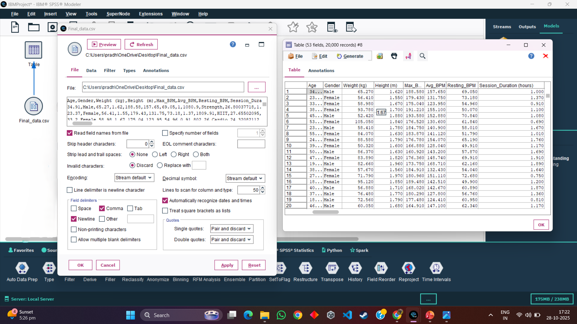
We will use Var.file node and Table node to import data and analyze dataset
First we take the Var.file node from the source palette and import it with the final_data and the click on apply and then ok
Further connect Var.file node with the Table node from the output palette and run it
After the table produced analyze the table and see patterns
There are 53 fields and 20000 records

Slide 5
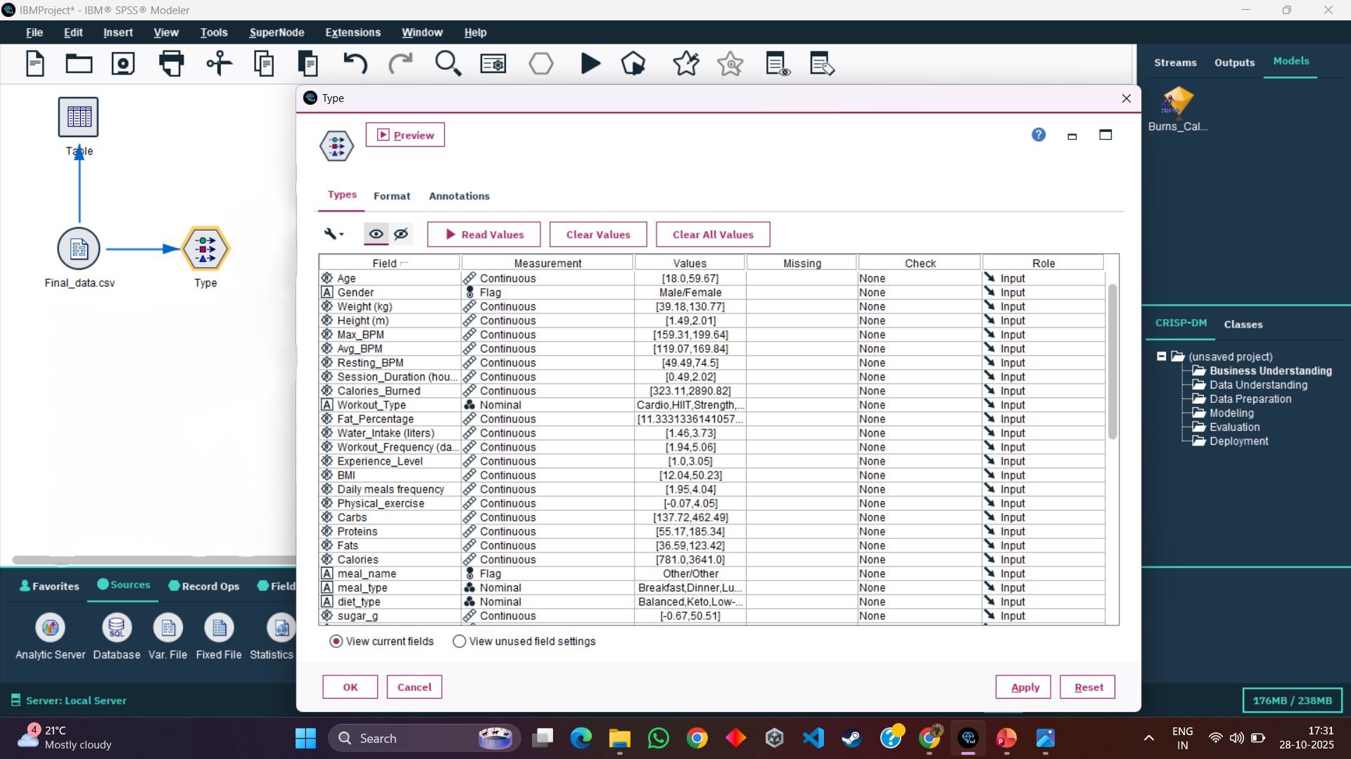
After that we will use Type node to analyze datatype and data of the datset
Now we have used the Type node from the Field Operations palette and connect it with the Var.file node
It is used to know the datatype of the data and we see all the attributes of our data and analyze the data

Slide 6
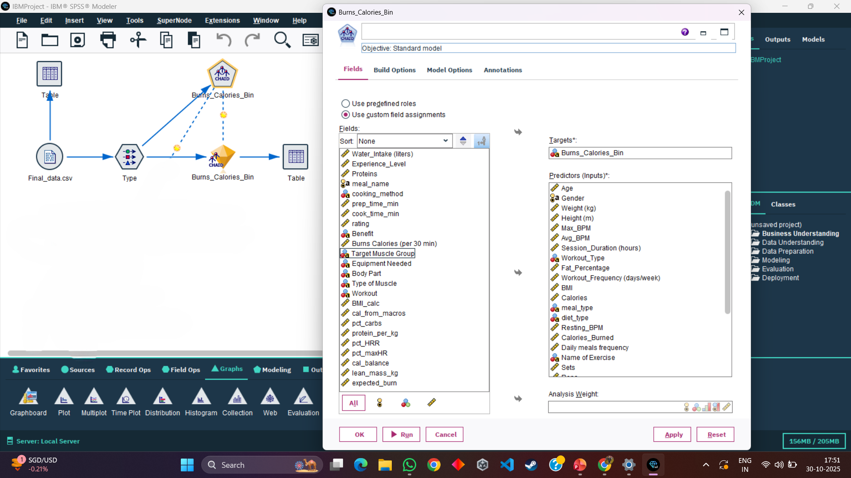
We will use the CHAID node and make the model and analyze the prediction
Then we connect the type node with the CHAID node from the modelling palette
In the CHAID node we will set the predictors (inputs) and the Targets
For Predictors we will select age, gender, weight, height, session_duration and etc & For Targets we will use Burns_Calories_bin
After that we will click on apply then run
Then we will get our model in the diamond shape

Slide 7
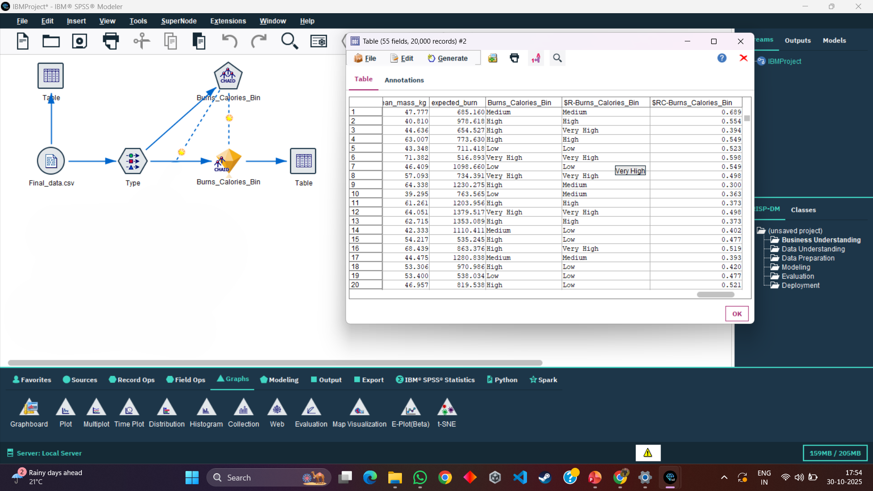
We will connect the model with the table to see the output
Then we connect our model with the table to see the output and analyze it
The new columns $R-Burns_Calories_Bin and $RC-Burns_Calories_bin which are the predicted ones

Slide 8
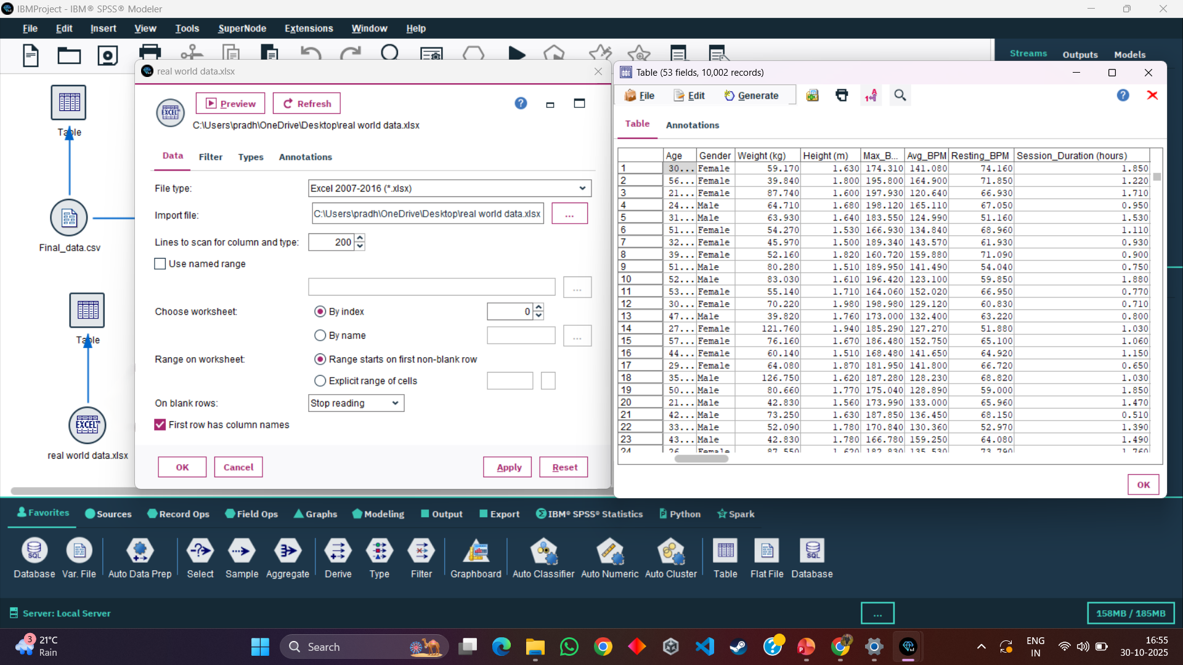
We will use the Excel node and import it with the real world dataset and connect with table
Now we will take a new excel node and import it with the real_world_data and click on apply and then ok
We can see the dataset there is 53 fields and 10002 records and we will apply the our model to test the dataset
Predict the amount of amount of calories burned

Slide 9
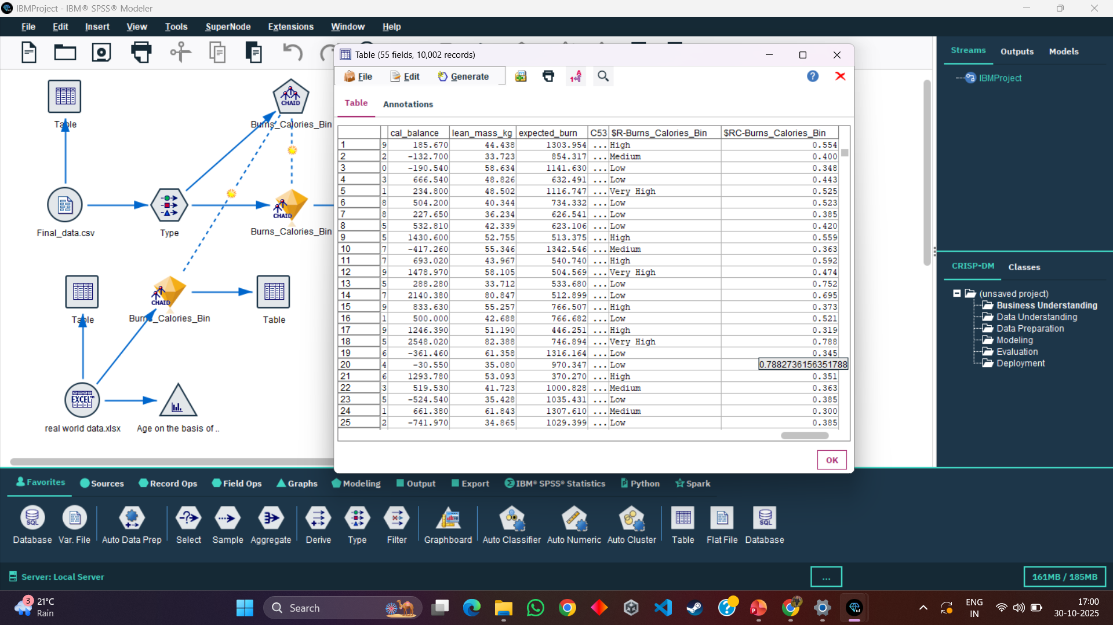
We will connect the our model with the Excel node and predict the model
Further we have connected the excel node with the model and then with the table to see the output
And we can clearly see the prediction in the output
It has predicted the amount of the calories burned as (very high, high, medium, low)

Slide 10
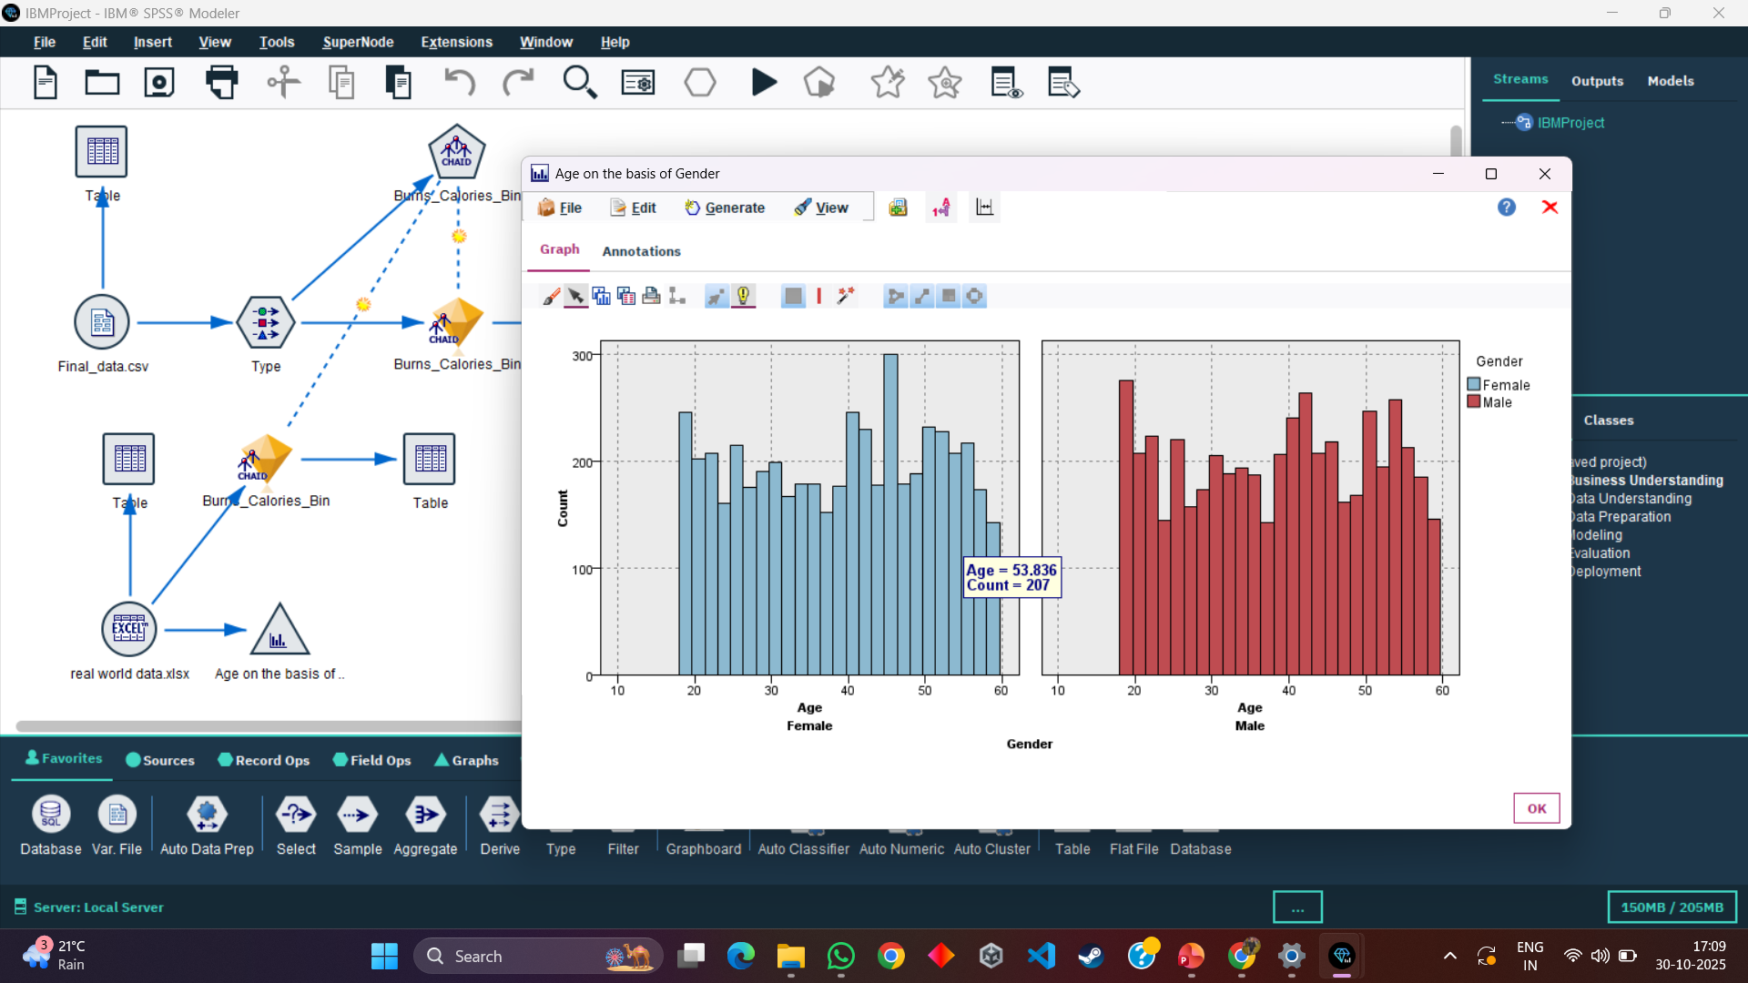
We will also connect the graph to get the count of male and female on the basis of age
We will also connect the histogram node from the graph palette from the excel node
As we can clearly see the graph for both male and female count on the basis of age

Slide 11
👨‍💻 Author Praveen Kumar Yadav Pradyumna singh Bhadoria Nitin Vishwakarma nitin Kumar Gupta
d

